Slide 1

Introduction to Large Language Models

Slide 2

The Evolution of NLP
2017 Onwards
Transformers and evolution
1950 - 1980
Symbolic NLP
1980 - 2000
Statistical NLP
2000 2017
Deep Learning

Slide 3

What are Large Language Models?

Slide 4
What are Large Language Models?
Large Language Model

Slide 5
What are Large Language Models?
Large
Language Model

Slide 6
What are Large Language Models?
Large
Language Model

Slide 7
Language Models
Language Models assign probabilities to a group of words in a sentence.
80%
Sentence 1 Life is good.
15%
Sentence 2 Good life is.
5%
Sentence 3 Is good life.

Slide 8

Example
I am going to school
Am I going school to?
Main school jaa raha hoon

Slide 9
Example
Which sentence is most likely to occur?
I am going to school

Slide 10

I am going to school Am I going school to
Main school jaa raha hoon 1%
19%
80%

Slide 11

p1 I am going to school p2 Am I going school to
p3 Main school jaa raha hoon 1%
19%
Language models assign probabilities to sequences of words that are likely to occur.
80%

Slide 12

Examples of Language Models
N-gram Language Models
Neural Language Models

Slide 13
Language models predict the most probable word that is likely to follow the preceding words.
Example : I hope you are ___________
95%
5%
at the airport.
doing well.

Slide 14
What is 'Large' in Large Language Models?

Slide 15
Language Model
Large

Slide 16
Timeline of Model Size
Earlier Language Models were trained on smaller datasets leading to fewer parameters.
By 2000
Models trained on hundreds of thousand parameters
By 2019
Models trained on hundreds of millions of parameters
By 2017
Models trained on millions of parameters
Post 2019
Models trained on billions of parameters

Slide 17
What are Parameters?
Weights & Biases

Slide 18
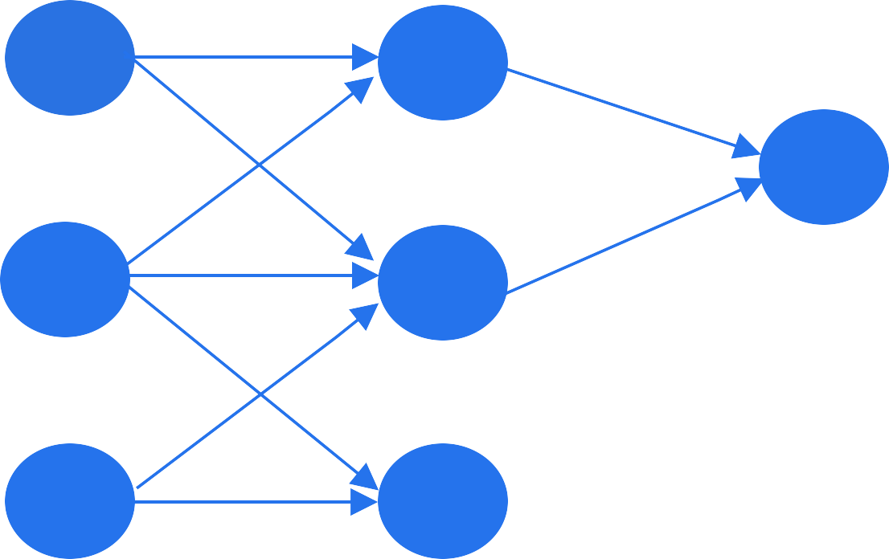



What are Parameters?
Neural networks learn the mapping between inputs and outputs through parameters
Input
Output
Input Layer
Middle Layer
Output Layer

Slide 19
Language Models vs Large Language Models
For Neural Language Models released in 2003, the number of Parameters was in the range
of millions.
Language Model
Millions)

Slide 20
Language Models vs Large Language Models
Large Language Models as of today contain billions of parameters.
Large Language Model
Billions)

Slide 21
Language Models vs Large Language Models
Language models gain intelligence with an increase in the size of training data and no. of parameters.
Language Model
Millions)
Large Language Model
Billions)

Slide 22
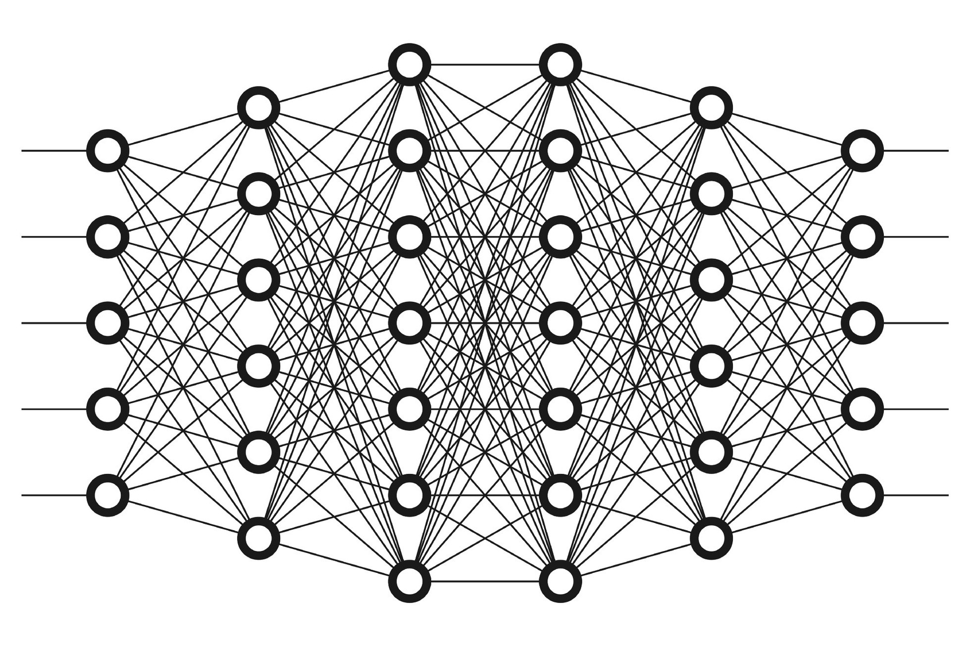
Language Models vs Large Language Models
The representation of inputs gets better with the increase in the depth of the network

Slide 23
Large size of training dataset
Large Refers:
Large number of parameters

Slide 24
What is a large language model?

Slide 25

Large language model contains an enormous number of parameters trained on massive datasets.

Slide 26

GPT and its evolution
1.8T
175B
117M
GPT 1
1.5B
GPT 2
GPT 3
GPT 4

Slide 27
Large language models gain emergent capabilities as they get bigger in terms of model and training data.

Slide 28

Emergent Properties
Emergent abilities are the set of properties that a model inherents during a training process.
GPT 3 is trained to predict the next word but can solve different tasks through completion.

Slide 29

Emergent Properties
How are you in hindi
Kaise ho

Slide 30
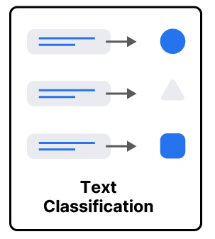
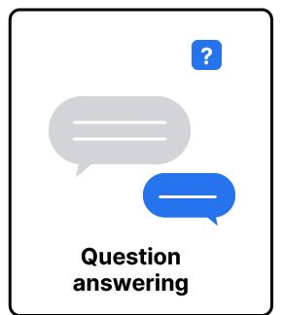



Use cases of LLMs
LLMs belong to class of foundation models

Slide 31
Thank You

